Slide 1
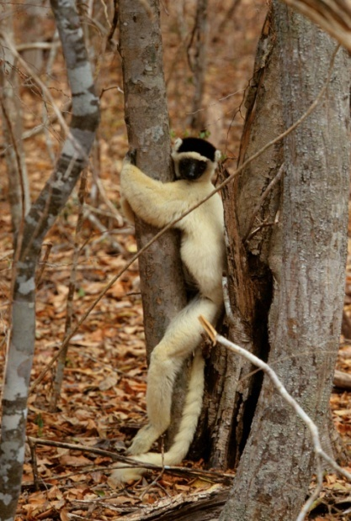

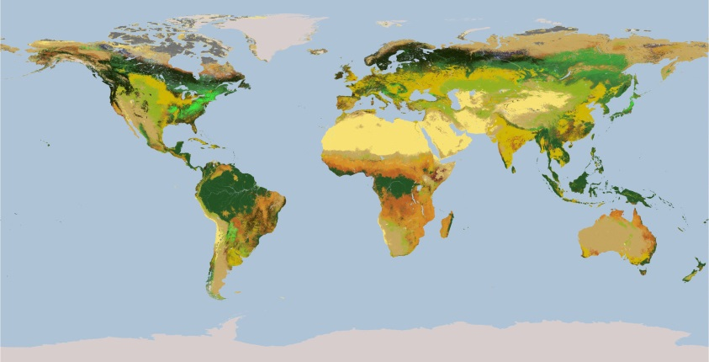
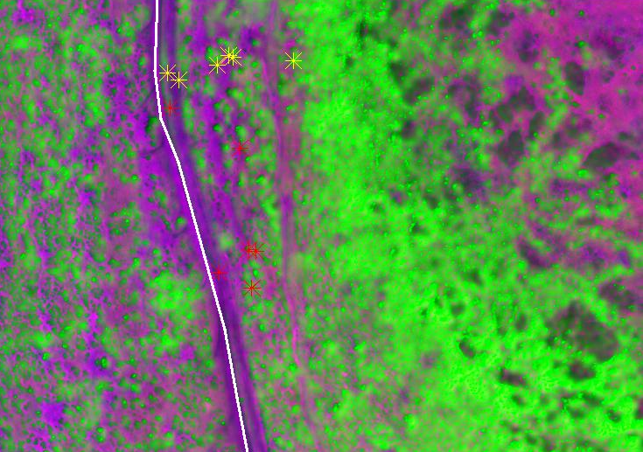
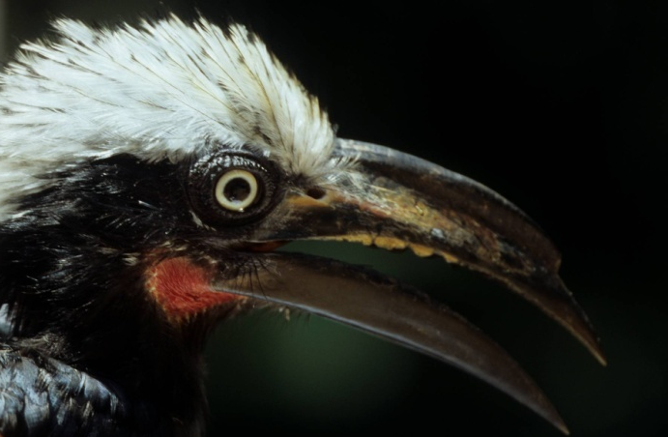
Integrating global species distributions, remote sensing and climate data to model biodiversity change
Mao-Ning Tuanmu, Yale University

Slide 2





Research Team
PIs:
Walter Jetz (Yale U), Rob Guralnick (U Florida), Brian McGill (U Maine), Rama Nemani (NASA Ames), Forrest Melton (NASA Ames)
Postdocs & students:
Giuseppe Amatulli (Yale U), Alberto Guzman (NASA Ames), Benoit Parmentier (NCEAS/ U Maine), Mao-Ning Tuanmu (Yale U), Adam Wilson (Yale U)
Software engineering, databases:
Jeremy Malczyk (Yale U), Map of Life Team (Yale, U Florida), Dave Thau (Google)
YCEI

Slide 3
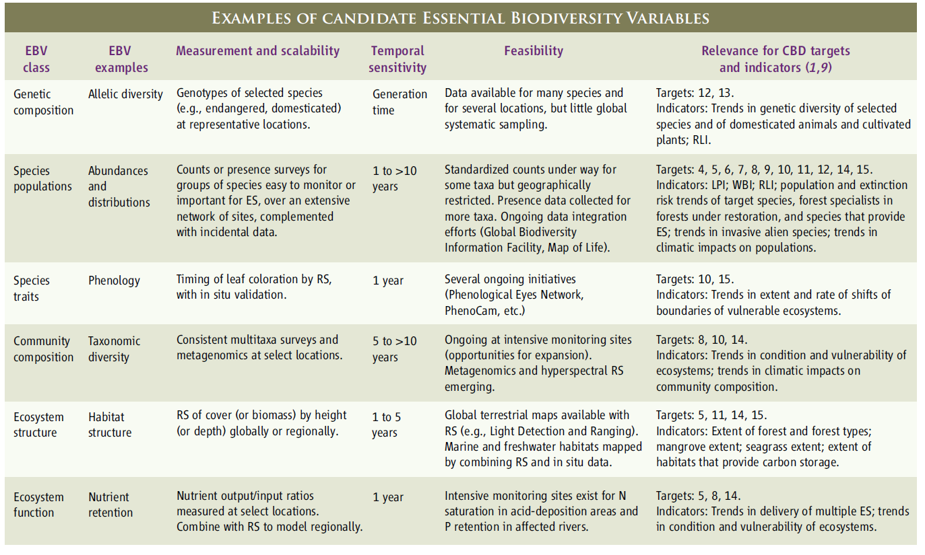
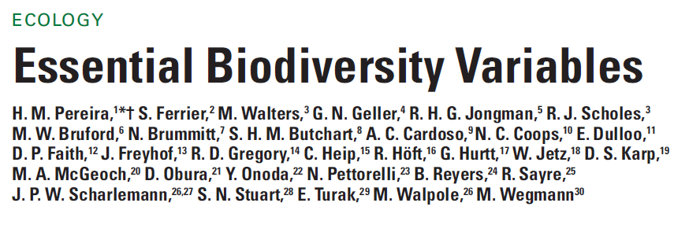
Essential Biodiversity Variables

Slide 4
Remote-sensing supported global terrestrial biodiversity monitoring
How to achieve a globally representative and generalizable biodiversity monitoring for scientifically rigorous assessment of change?
What can remote sensing contribute?
Observation
Observed|Predicted Change
Models
Biological
attribute
Environment
Space
Space
Biological
attribute
Time
Space
Time
Time
Environmental drivers

Slide 5
Remote-sensing supported global terrestrial biodiversity monitoring
Developing remote sensing-based, global fine-grain (1km) environmental data layers specifically for biodiversity modeling
Better assessing the state of biodiversity
Detecting, monitoring and predicting biodiversity change

Slide 6
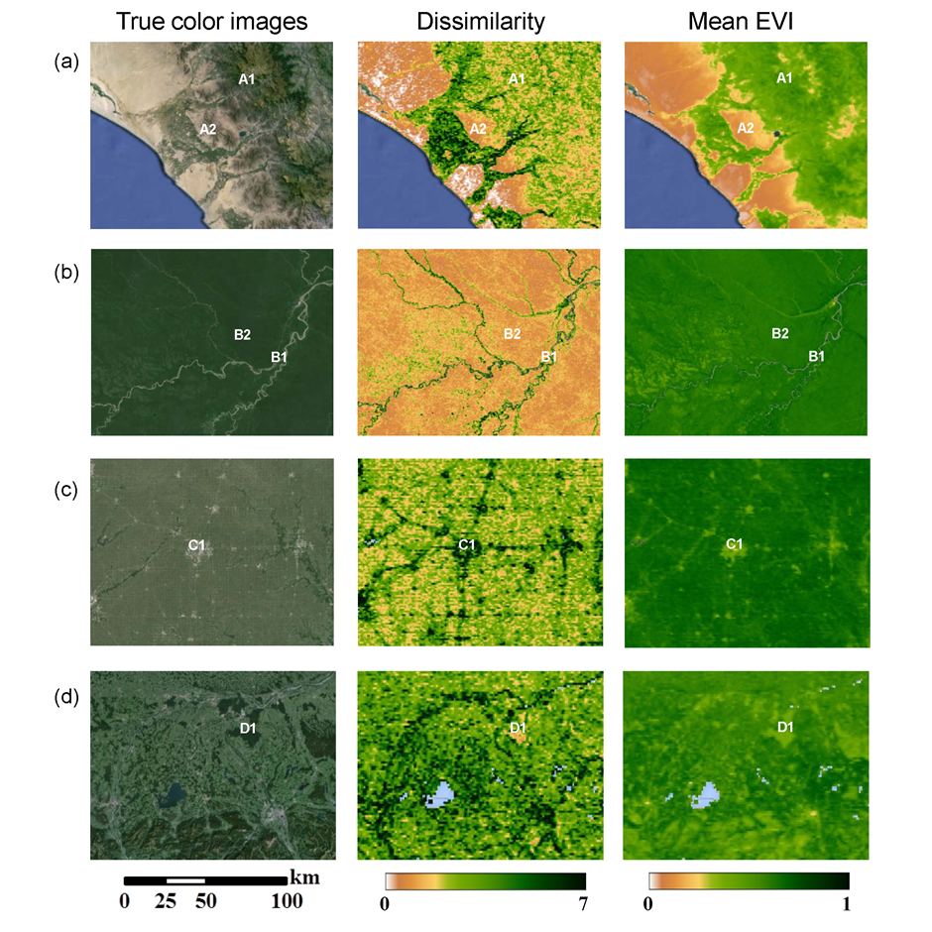
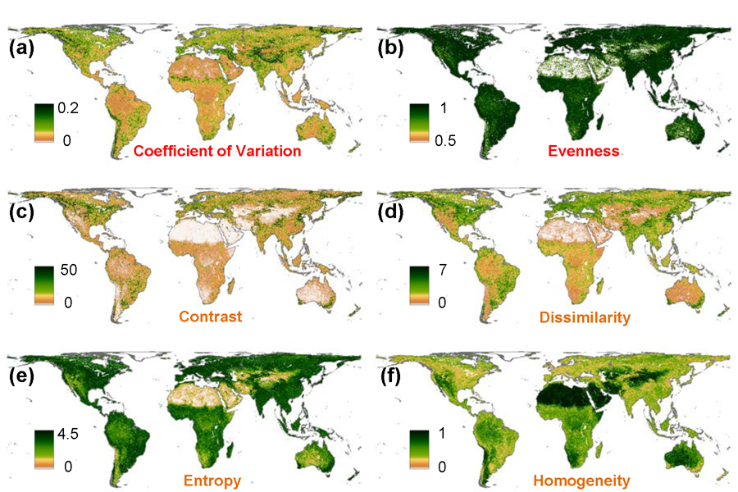
Ecologically relevant environmental variables – Land cover/vegetation
Spatial heterogeneity of habitat
  Textural features of MODIS EVI
Tuanmu & Jetz, in review

Slide 7
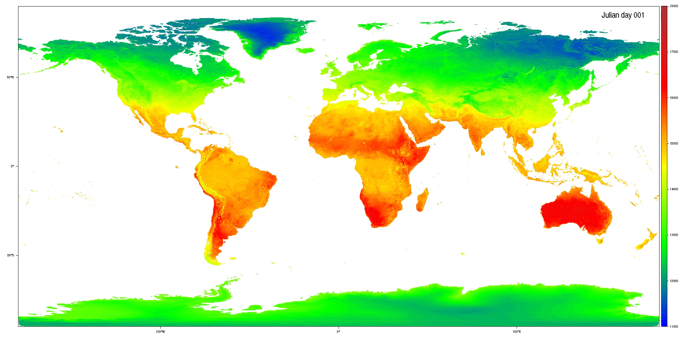
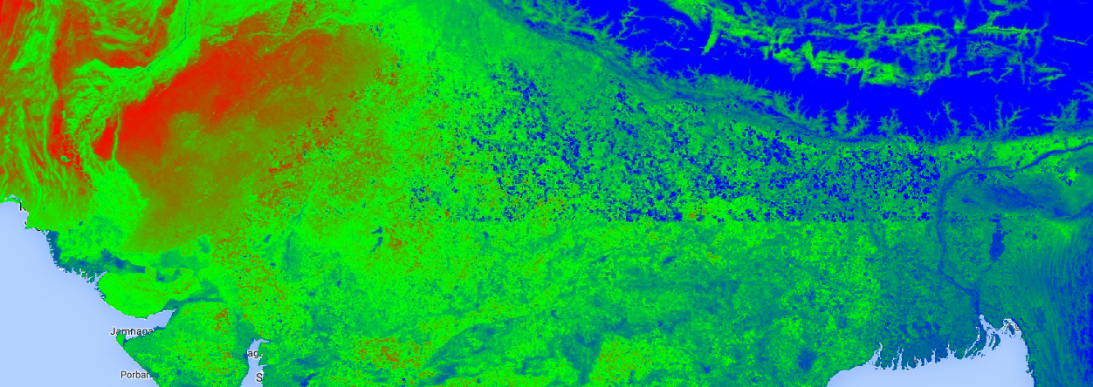
Ecologically relevant environmental variables – Climate
Land surface temperature (daily and monthly climatologies)
Amatulli et al, in prep
across-year mean for DOY209

Slide 8
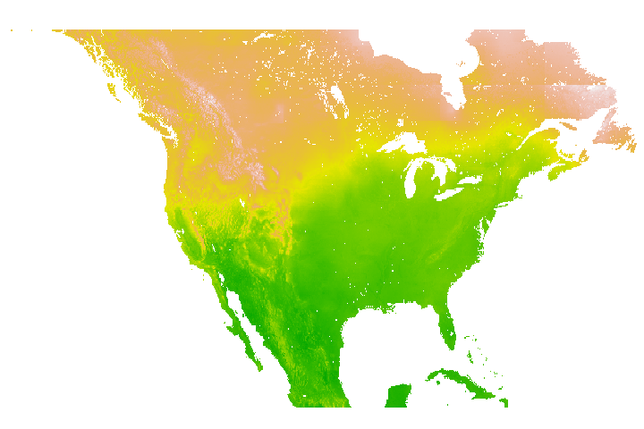
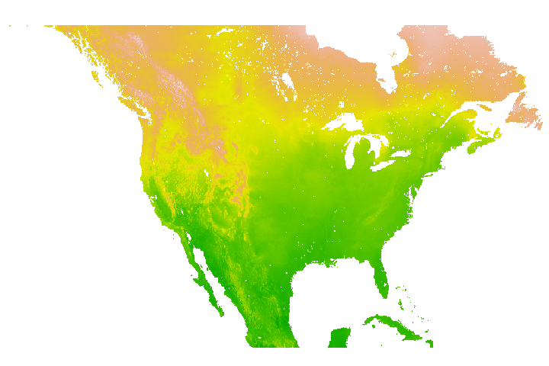
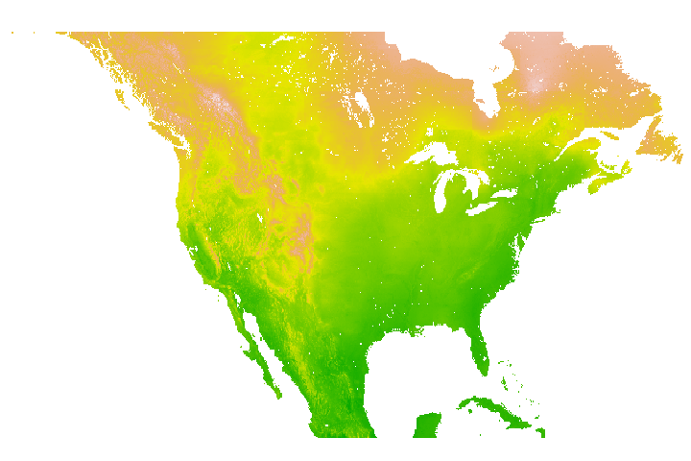
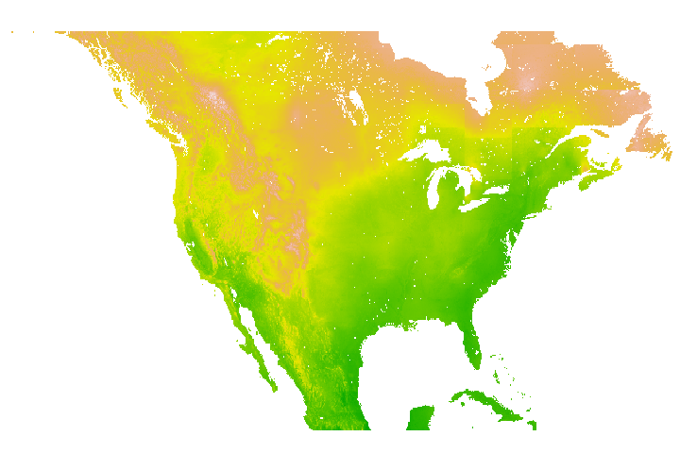
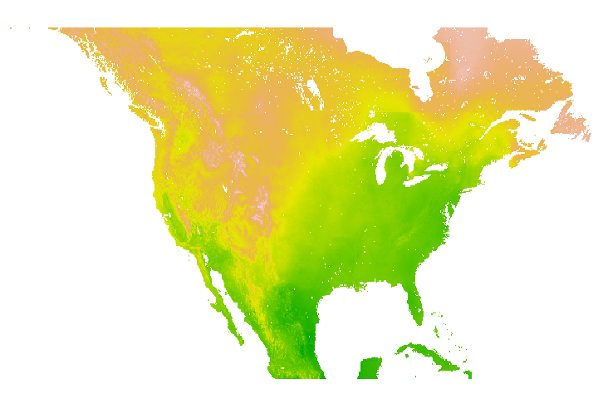
Ecologically relevant environmental variables – Climate
Air temperature
May 5, 2010
May 4, 2010
May 3, 2010
May 2, 2010
May 1, 2010
Fusion of MODIS Land Surface Temperature and cloud mask with daily observations from weather stations
Daily, global , 1km ambient temperature layers 2001 (and earlier) to 2014, RMSE: ~2°C
Available: late 2015, follow earthenv.org (contact us for earlier use).

Slide 9
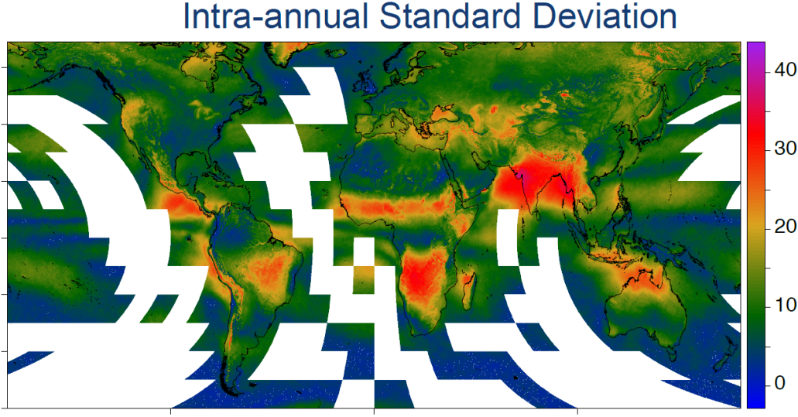
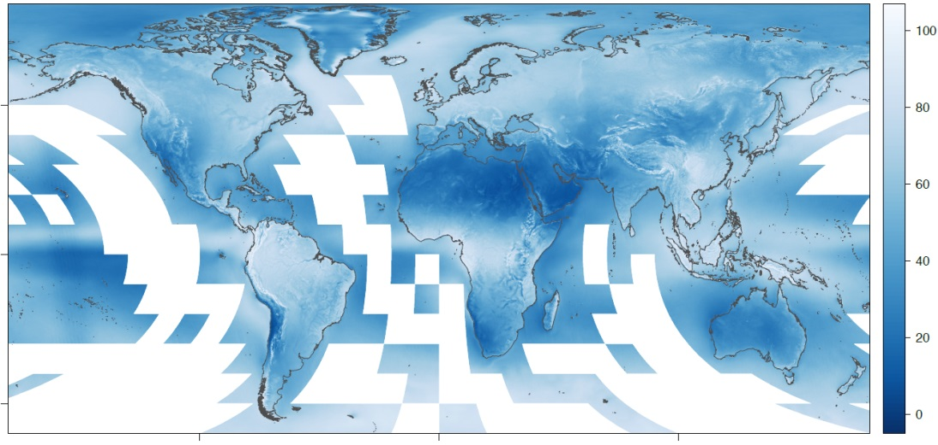
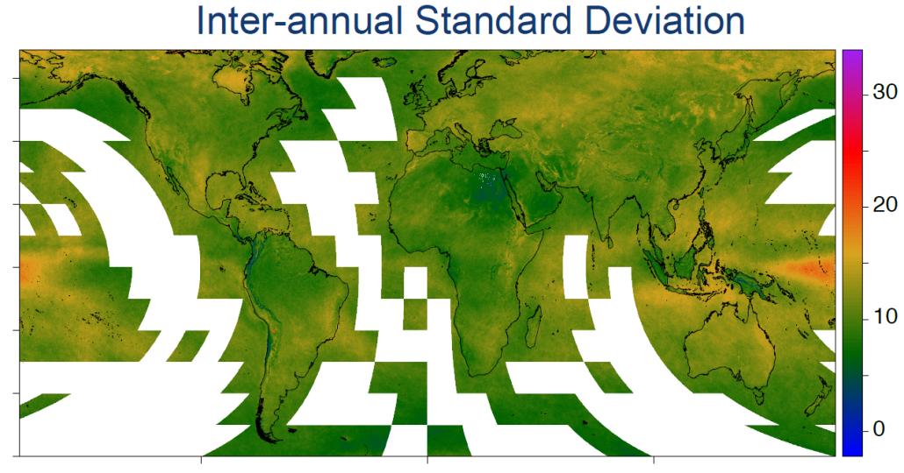
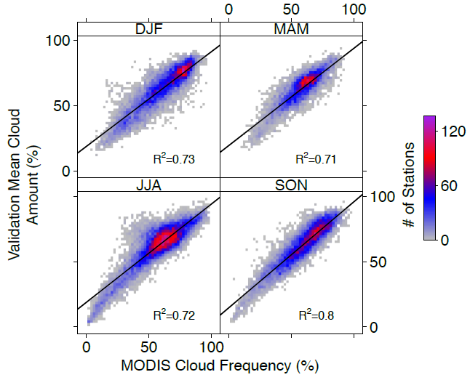
Biodiversity-relevant environmental variables – Climate
Cloud cover frequency
Mean Annual Cloud Frequency (2000-14) (%)
Wilson & Jetz, in review

Slide 10
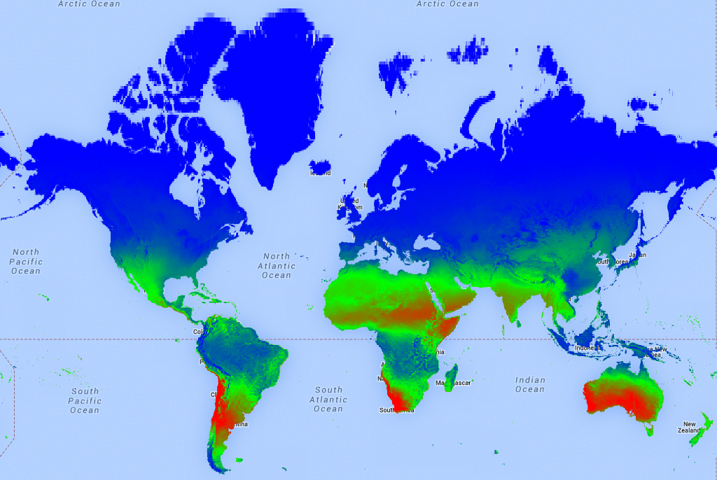
Biodiversity-relevant environmental variables – Energy/productivity
Solar radiation (including cloud effects)
Amatulli et al, in prep

Slide 11
Remote-sensing supported global terrestrial biodiversity monitoring
Developing remote sensing-based, global fine-grain (1km) environmental data layers specifically for biodiversity modeling
Better assessing the state of biodiversity
Detecting, monitoring and predicting biodiversity change

Slide 12
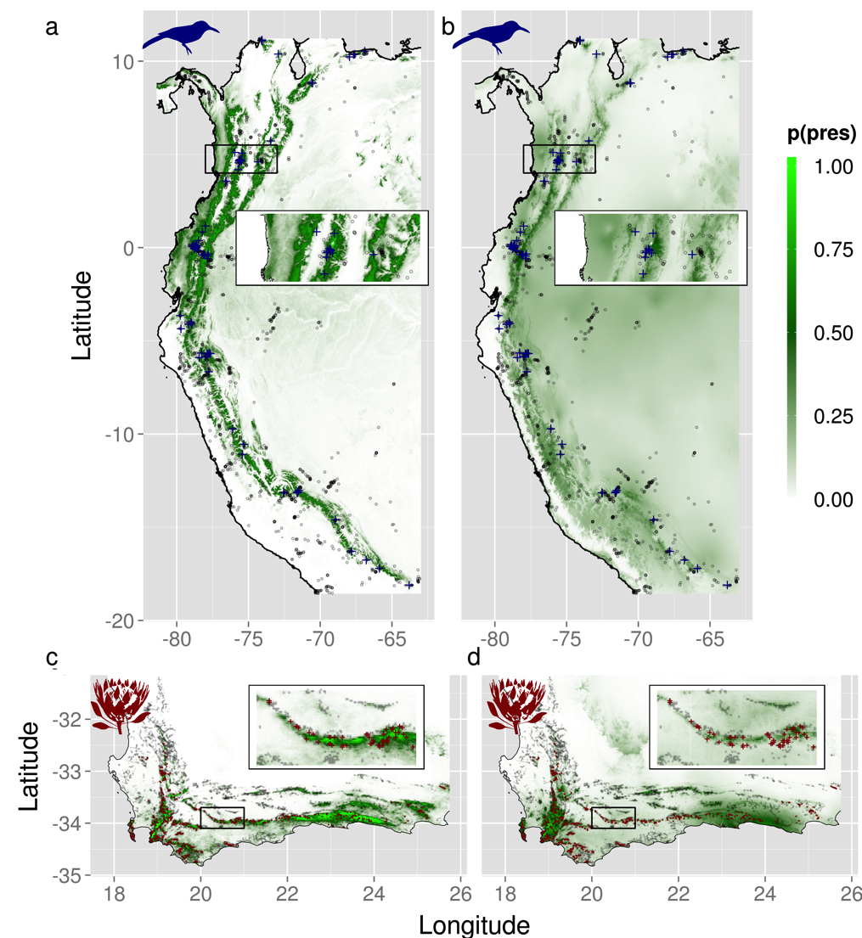
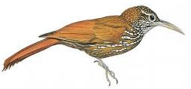
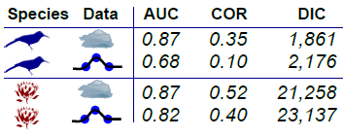


Biodiversity status – Species distribution
MODIS - observed
Interpolated

Slide 13
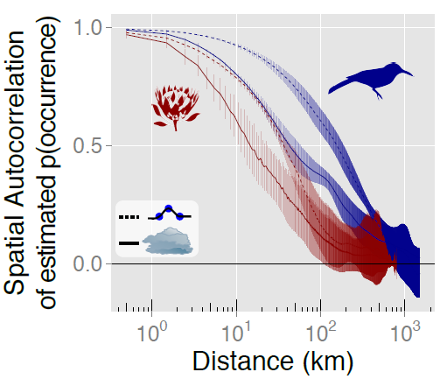
Biodiversity status – Species distribution
Inflated spatial autocorrelation

Slide 14
Biodiversity status –
Species richness & functional diversity
Texture measures vs. conventional heterogeneity metrics
Better
First-order and second-order texture metrics
>
Topography-based and land-cover-based metrics
Tuanmu & Jetz, in review

Slide 15
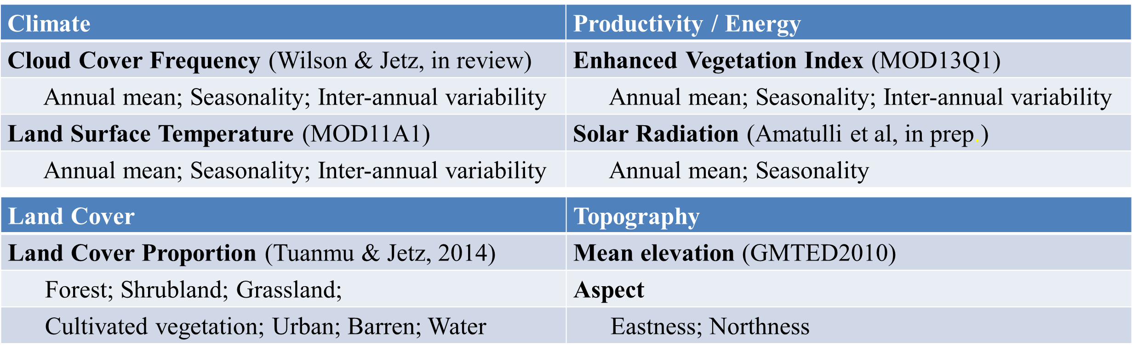
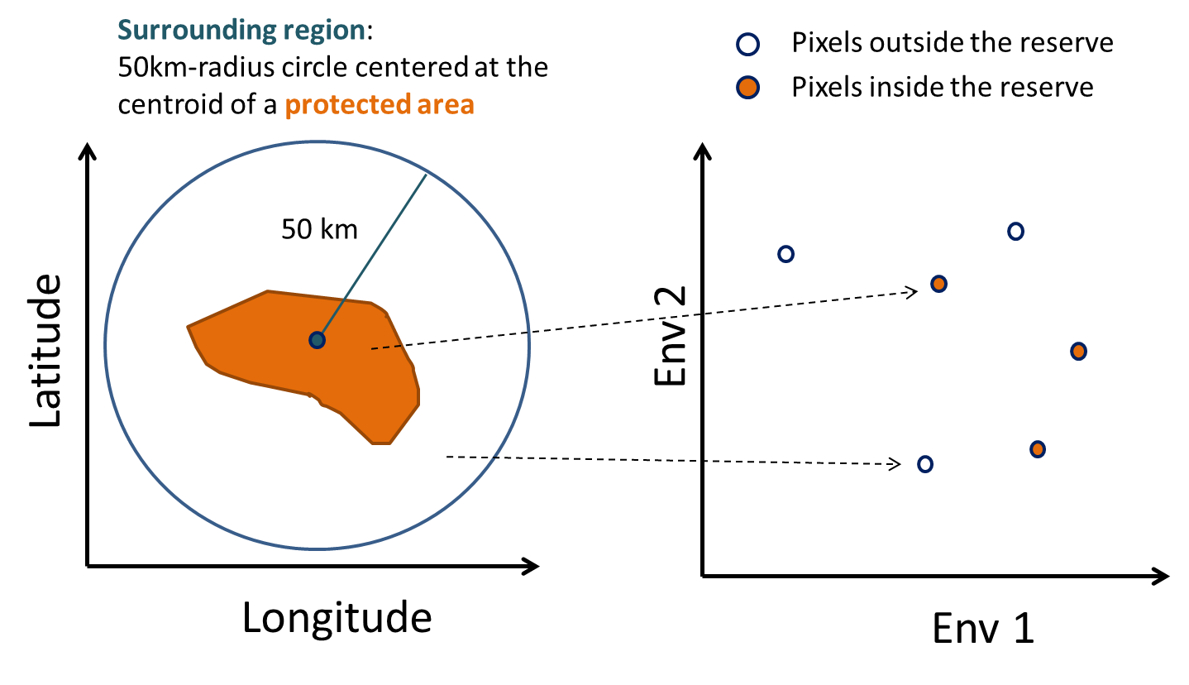
Biodiversity status –
Biodiversity representativeness of reserves
Environmental representativeness as a surrogate

Slide 16
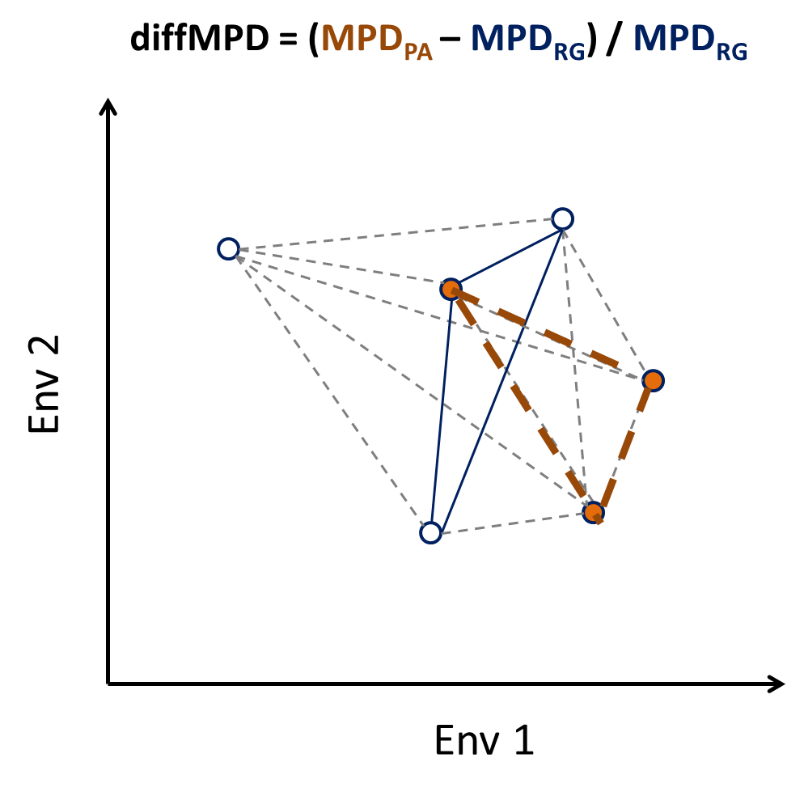
Biodiversity status –
Biodiversity representativeness of reserves
Environmental representativeness
Tuanmu & Jetz, in prep

Slide 17
Biodiversity status –
Biodiversity representativeness of reserves
RMSE: 0.13
Pseudo-R²: 0.31
Tuanmu & Jetz, in prep

Slide 18
Remote-sensing supported global terrestrial biodiversity monitoring
Developing remote sensing-based, global fine-grain (1km) environmental data layers specifically for biodiversity modeling
Better assessing the state of biodiversity
Detecting, monitoring and predicting biodiversity change

Slide 19
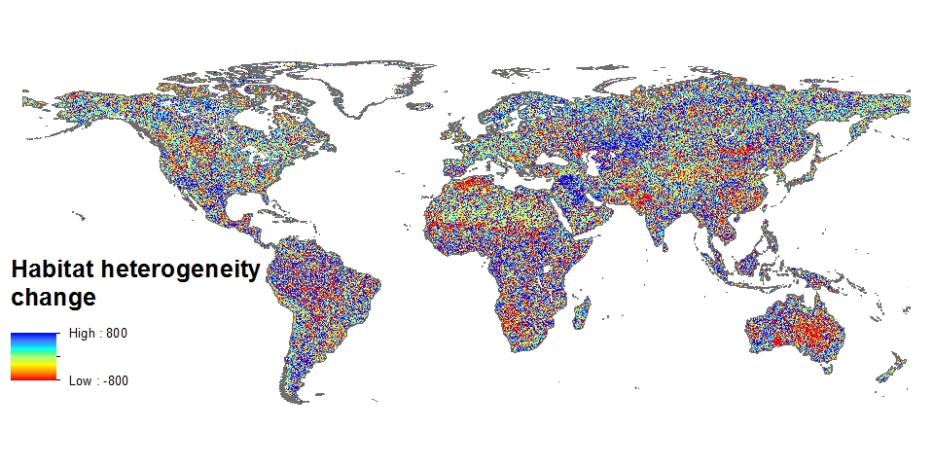
Biodiversity monitoring –
Changes in biodiversity-relevant factors
2003 - 2011
Homogenization
Heterogenization

Slide 20
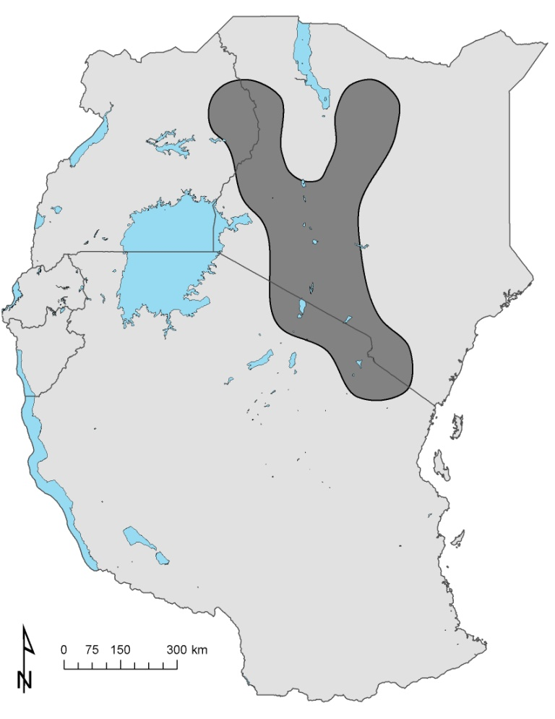
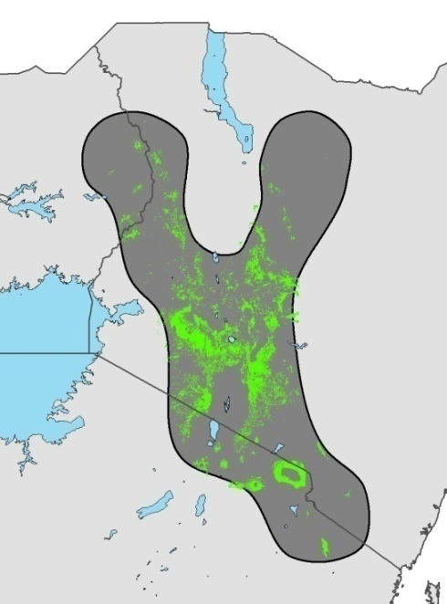
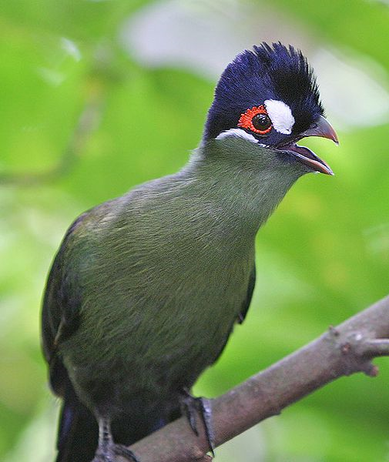
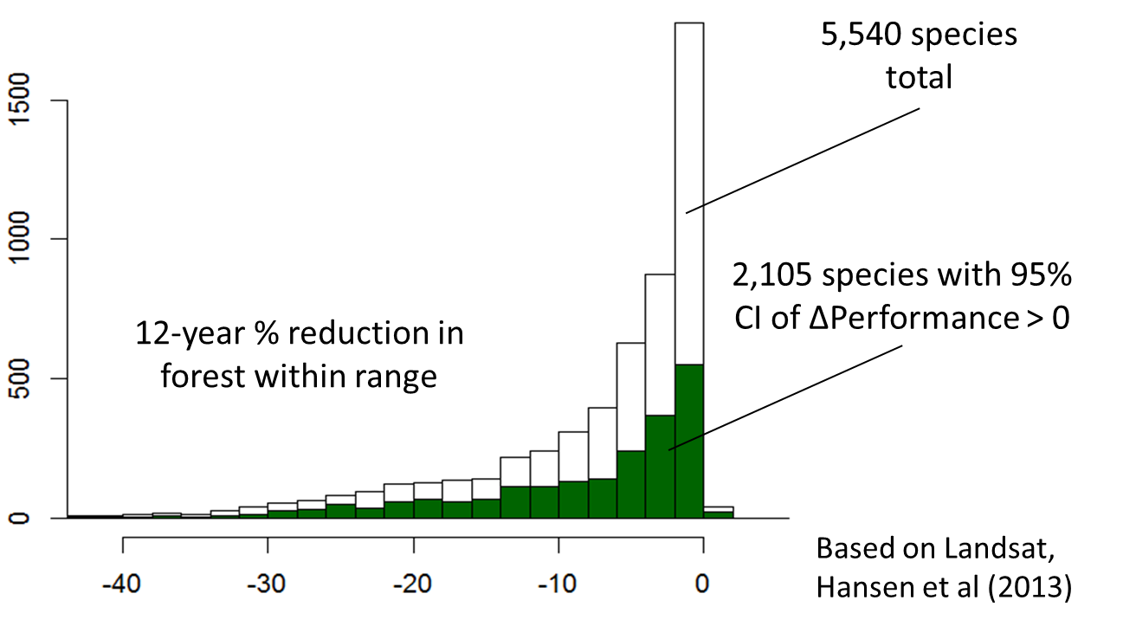
Biodiversity monitoring – Deductive models
Expert range: 180,000km²
1
Species distribution refinement and change monitoring
Landcover 2001-2012
Hartlaub’s Turaco Predicted range size 2001: 23,000km²
2012: 21,700km²
2
Region species prediction, change monitoring
Region A - Probability Species is Present:
2001: 0.28 (± 0.03)
2012: 0.23 (± 0.05)
Region A - Predicted bird richness:
2001: 189 (± 7.4)
2012: 179 (± 5.6)
Hartlaub’s Turaco: forest specialist, >1500m elevation
Expert range
Suitable 2012
Primary forest specialist vertebrates
Jetz et al, in prep

Slide 21
Biodiversity monitoring – Inductive models
Predictions
Quality Control
Map of Life
Bayesian Hierarchical Models
Global 1km environmental layers
Global spatial biodiversity data
Models
Inference
Static
Topography
Change in:
Species niches
Species distributions
Taxonomic diversity
Functional diversity
Phylogenetic diversity
√
Dynamic
(daily 1980-2014)
Temperature in progress
Precipitation in progress
Bioclimatic variables in progress
Extreme events in progress
Semi-dynamic
Cloud cover
Land cover
Solar radiation
Habitat Heterogeneity
Productivity
√
√
1980s - 2014
√
√
√

Slide 22
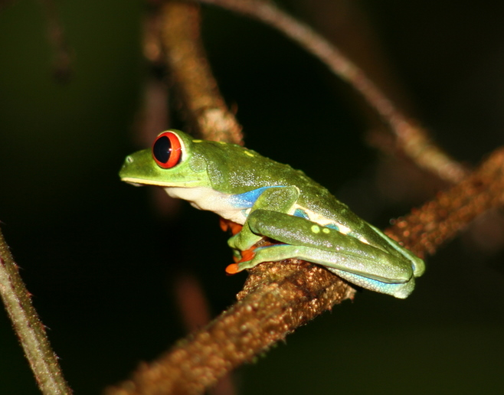
Thanks!

Slide 23
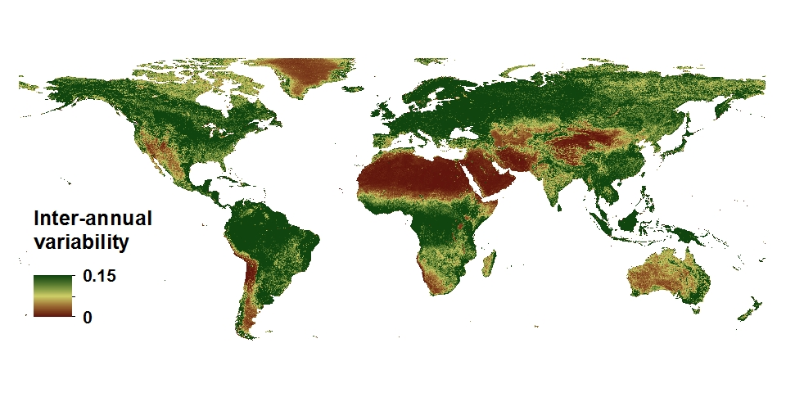
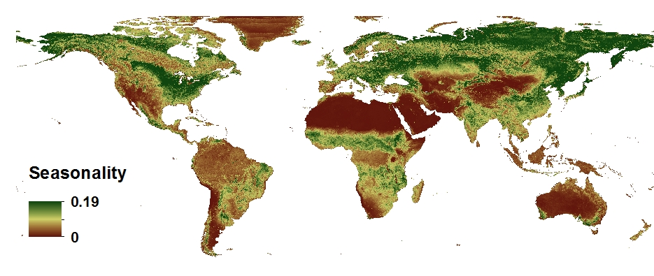
Ecologically relevant environmental variables – Land cover/vegetation
Temporal variability of habitat
2001-2014 MODIS EVI

